Slide 1
Tool Mark Analysis
Mrs. Ashley

Slide 2
What are tool marks?
Hard tools leave impression marks on softer materials, these tools are often used to gain mechanical advantage
These can be things such as: impressions, gouges, gash, slash, groove, channel, dent, indentation, hole, scratch, abrasion, striation
Ballistics is a type of tool mark
Tool marks are affected by the surface on which they occur

Slide 3
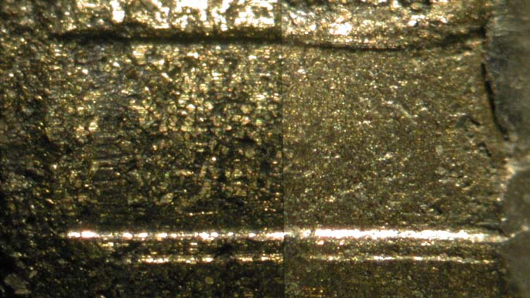
This is a tool mark that is inconclusive

Slide 4
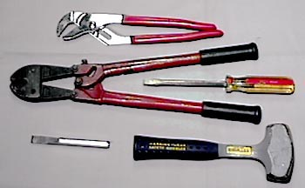
Different Tools Make Different Tool Marks

Slide 5
Types of Tool Marks Based on How Used
Compression
Outline of tool is seen
Dimensions are easy to determine
Examples are: pliers, bolt cutter
Sliding
Usually consist of parallel striations
Class characteristics more difficult to determin
Examples are: screwdrivers, chisels, pry bars, crow bar
Cutting
Combination of sliding and compression
Cutting tool indents and then clides

Slide 6
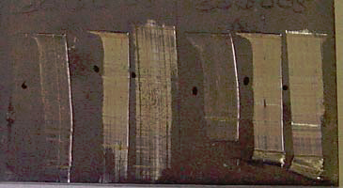

Slide 7
Collecting Evidence
Tools and tool marks may contain trace evidence which needs to be collected also
Always look for tool marks at points of entry
Look for tool marks when there is a burglary
Safes and cabinets may contain pry marks
Look for cutting marks on hasps, chains, and chain link fences

Slide 8
Collecting Evidence
Suspect tool and tool marks must be packed in separate containers
Never put a tool within the tool mark to look for a match.
Any contact between the tool and the marked surface may alter the mark and will, at the least, raise serious questions about the integrity of the evidence.

Slide 9
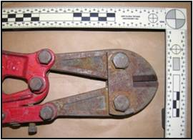
Class Characteristics of Tools
Indicate the source of the tool, from the tool design
Ridges and valleys made during manufacture
Dimensions are easy in comparison: size, shape of each part of tool
Patterns in tool made during manufacture

Slide 10
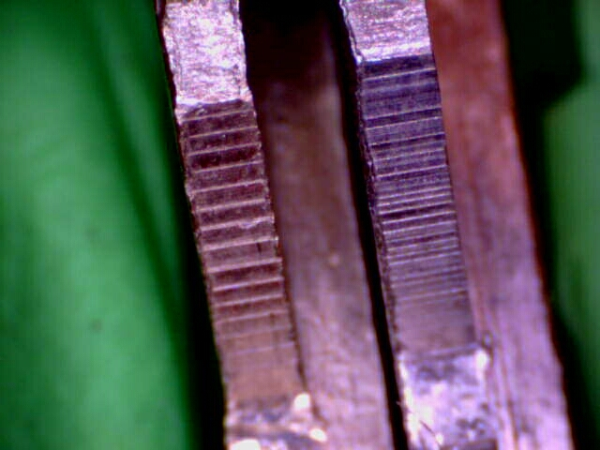
Individual Characteristics of Tools
Comparison of striations, defects, breaks unique to a specific tool from use or abuse
These marks are usually made during use
It is the minute imperfections that identify
Picture on right shows
two keys cut by two
different key cutters

Slide 11
Tool Mark Analysis
If possible, transport the item from the crime that has the tool mark
Make a cast of the crime scene tool mark if it cannot be transported using a silicone based material
Make several casts of the test tool mark for comparison (soft lead is often used for the marks)
In casting the tool marks for comparison, they must be made at similar angle and pressure to be statistically valid
Different materials for the comparison cast may be used depending on where the tool mark is located (cream silicone or putty, used for vertical surface)

Slide 12
Making the Comparison
Specific size of each part of the tool and the tool mark for comparison are taken
Drawings, notes, and photographs are taken, but not used for final comparison, since they are not specific enough.
Drawings and photographs are used to give clues as to how the crime scene marks were made
Cast should include microscopic detail

Slide 13
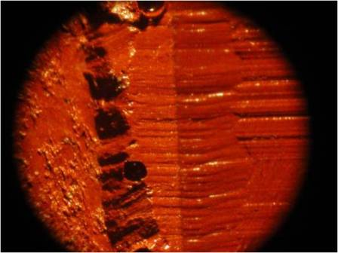
Picture Showing Comparison

Slide 14
Matching Striae
Method called Consecutive Matching Striae (CMS)
Patterns are quantified
Positions of striae relative to a reference point
Height and width of striations
Consecutive series of known height and width striae
Number for reliability is at least 10 exact matches

Slide 15
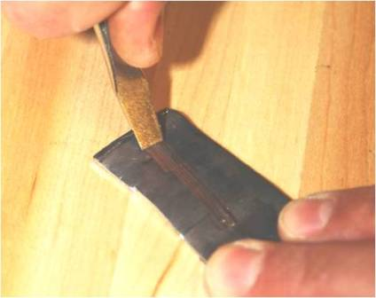
Tool Marks more difficult to match
Firearms are always fired with the same firing pin and tools can be used in many different ways

Slide 16
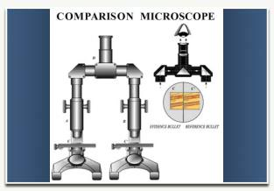
Making the Comparison
Look at cast of crime scene tool mark and cast of suspected tool by comparison microscope or digital microscopic pictures of each

Slide 17
Results of Comparison
3 Typical Results
Positive Identification
Tool marks are made by the submitted tool
At least enough of the individual characteristics are an exact match to be conclusive
Negative Identification or eliminated
Significant disagreement between class and individual characteristics
Inconclusive
The class characteristics match, but agreement of individual characteristics is insufficient
Unsuitable
Sample is not appropriate for comparison

Slide 18
Unusual and Unique Tool Marks
Fingernails ( each person’s fingernail has specific ridges at specific locations)
Tool marks that make a drug tablet or a forged drug tablet
If unsure of what are class characteristics or individual characteristics, you may need to speak to the manufacturer to obtain more information

